Slide 1
AI-based Web Platform
Yu-Wei Chang
Supervised by Albert C. Yang, M.D., Ph.D.

Slide 2
If you are interested in…
Hosting a hello-world web
Hosting a dicom-rendering web
Hosting a web integrated with ML model
Developing model with tensorflowJS, using ML model in the browser or nodejs directly
This is for you!

Slide 3
Agenda
Setup your notebook
Briefing on the framework
Hands-on web-hosting in YOUR notebook
What to do with current projects

Slide 4
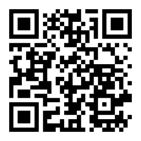


Setup your notebook
Get the demo code
https://github.com/maverickyuwei/demo_ai_web_platform
Follow the instruction in README

Slide 5
How does it work
http://chestxray-ai.com/

Slide 6
How does it work
Display
Scripting
Training
UI/UX
DB admin
Predicting
Upload
API
Front-end
Back-end
AI-algorithm

Slide 7




How does it work - chest X-ray for example
DCM viewer
Scripting
Training
Assessment results
API
Predicting
Front-end
Back-end
AI-algorithm

Slide 8
Lets play with it…
Step1. Hello-World
Step2. Render an index.html
Step3. Host a DCM viewer page
Step4. Upload a DCM file
Step5. Call ML model and return the results

Slide 9
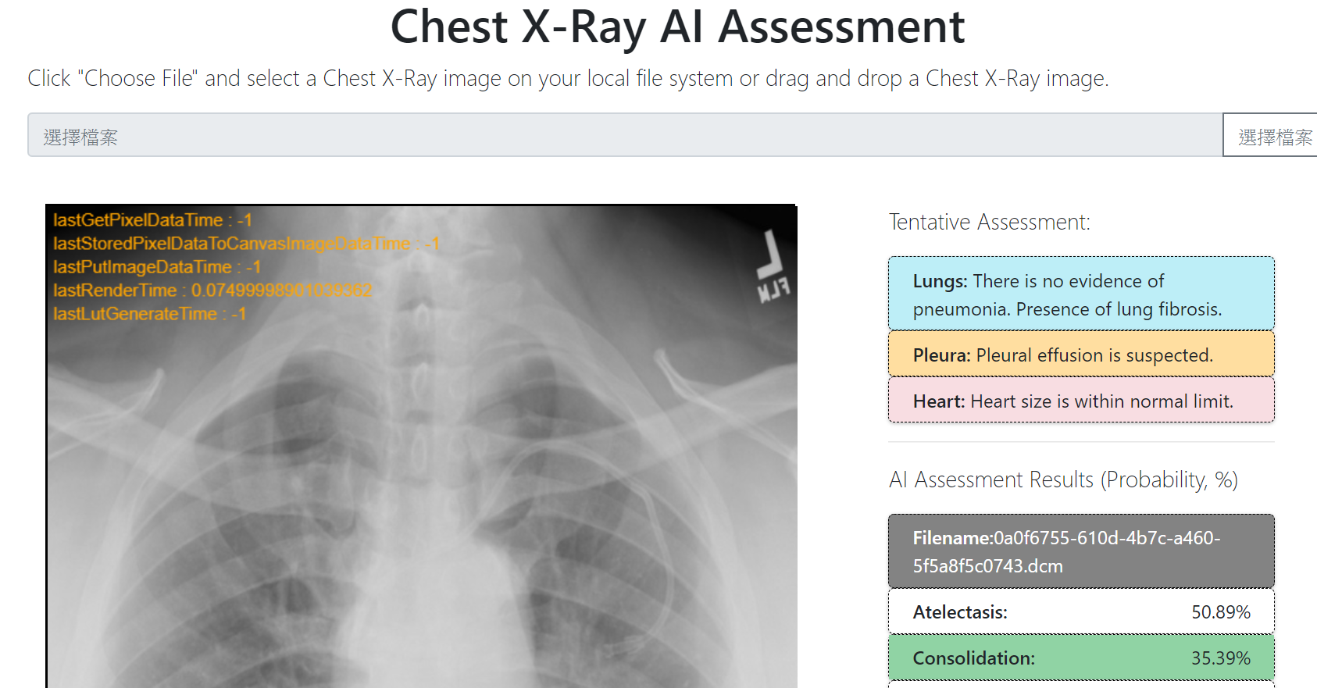
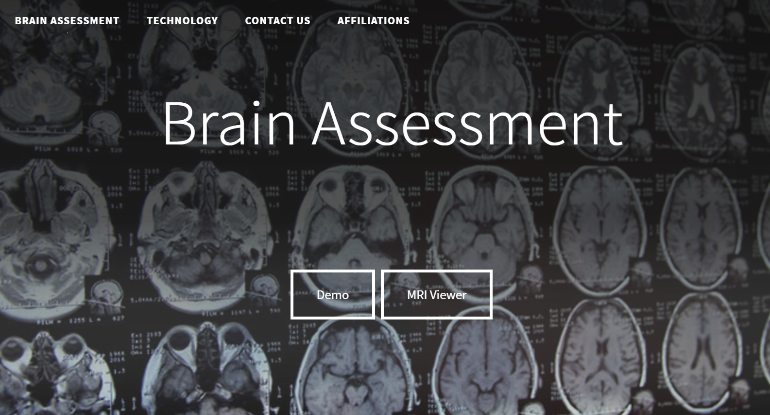

Current projects
肺炎診斷平台
腦影像診斷平台
睡眠平台

